Slide 1
E Learning Platform
By,
Apoorva
Rohith
Pavan
Raja
Deekshith

Slide 2
Introduction

Slide 3
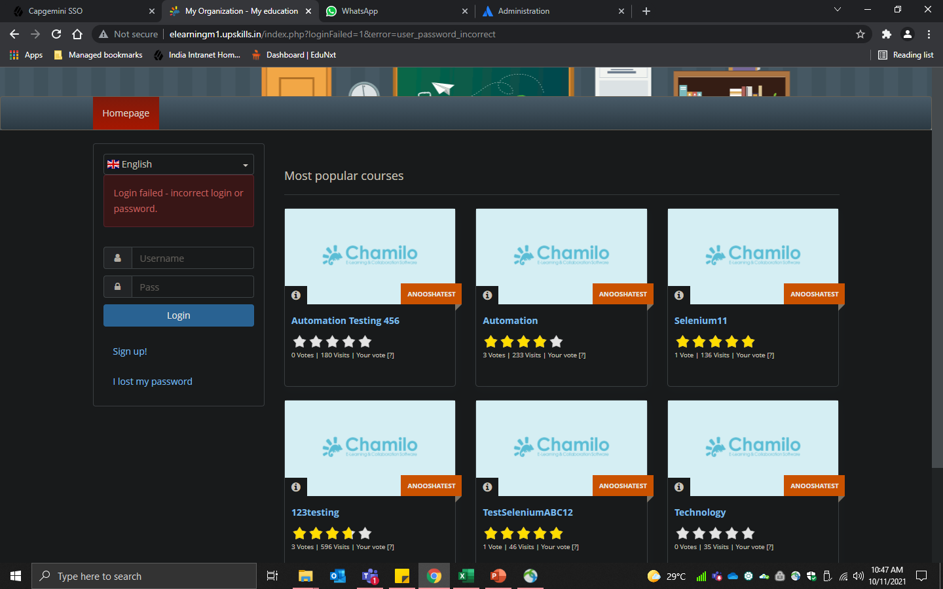
Login page

Slide 4
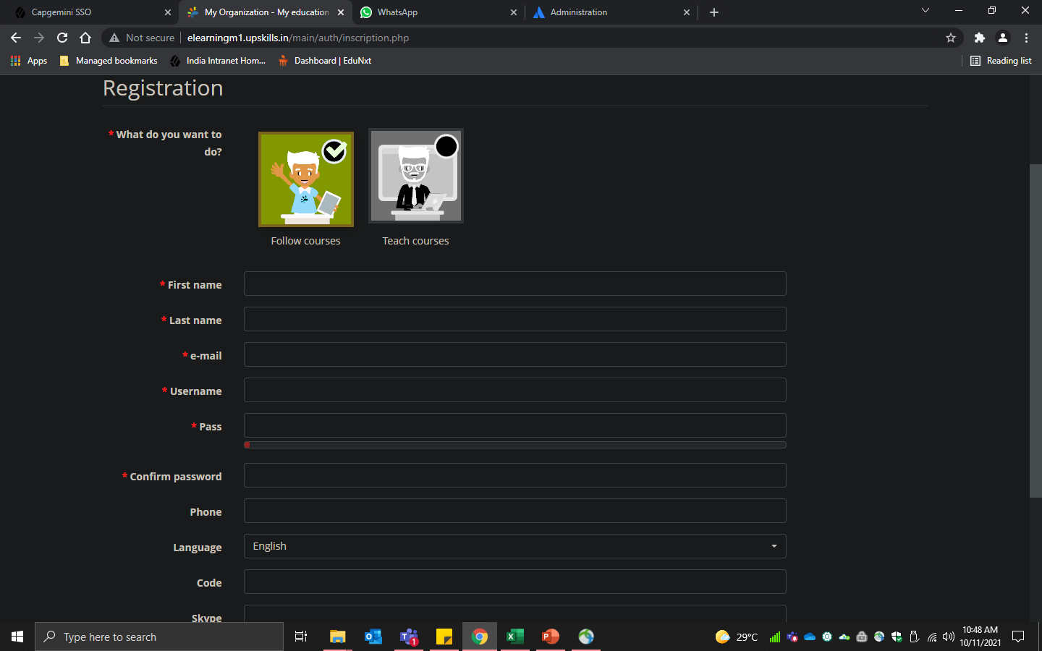
Sign Up Page

Slide 5
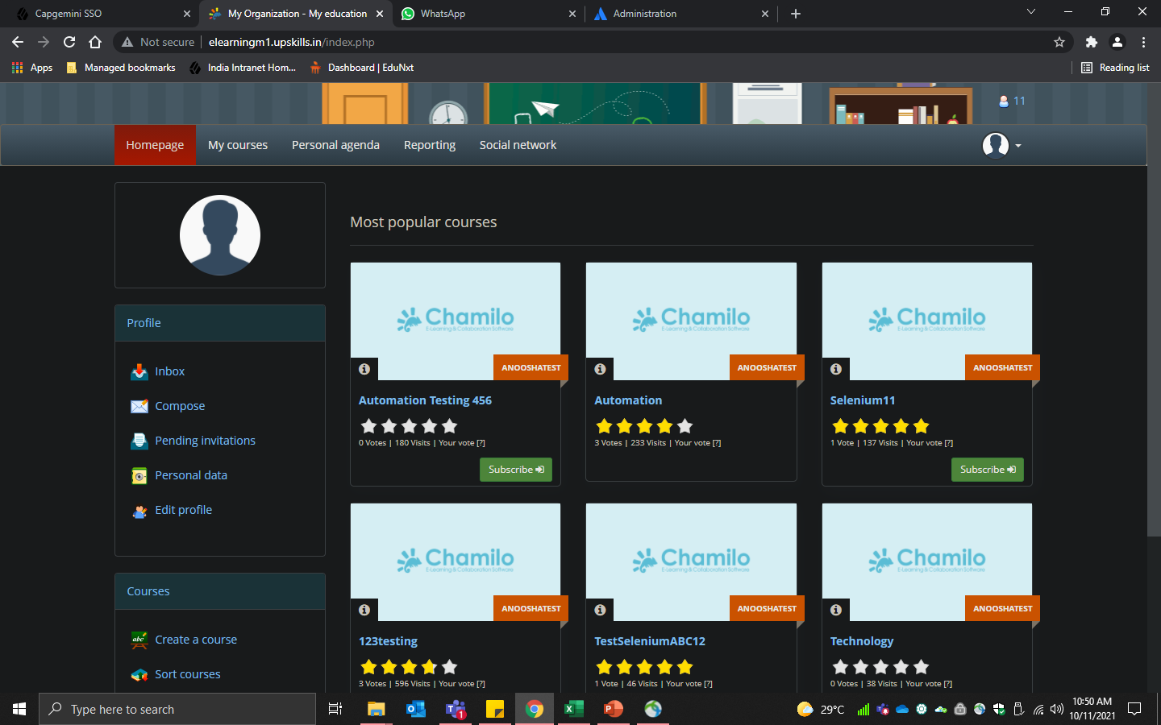
Homepage

Slide 6
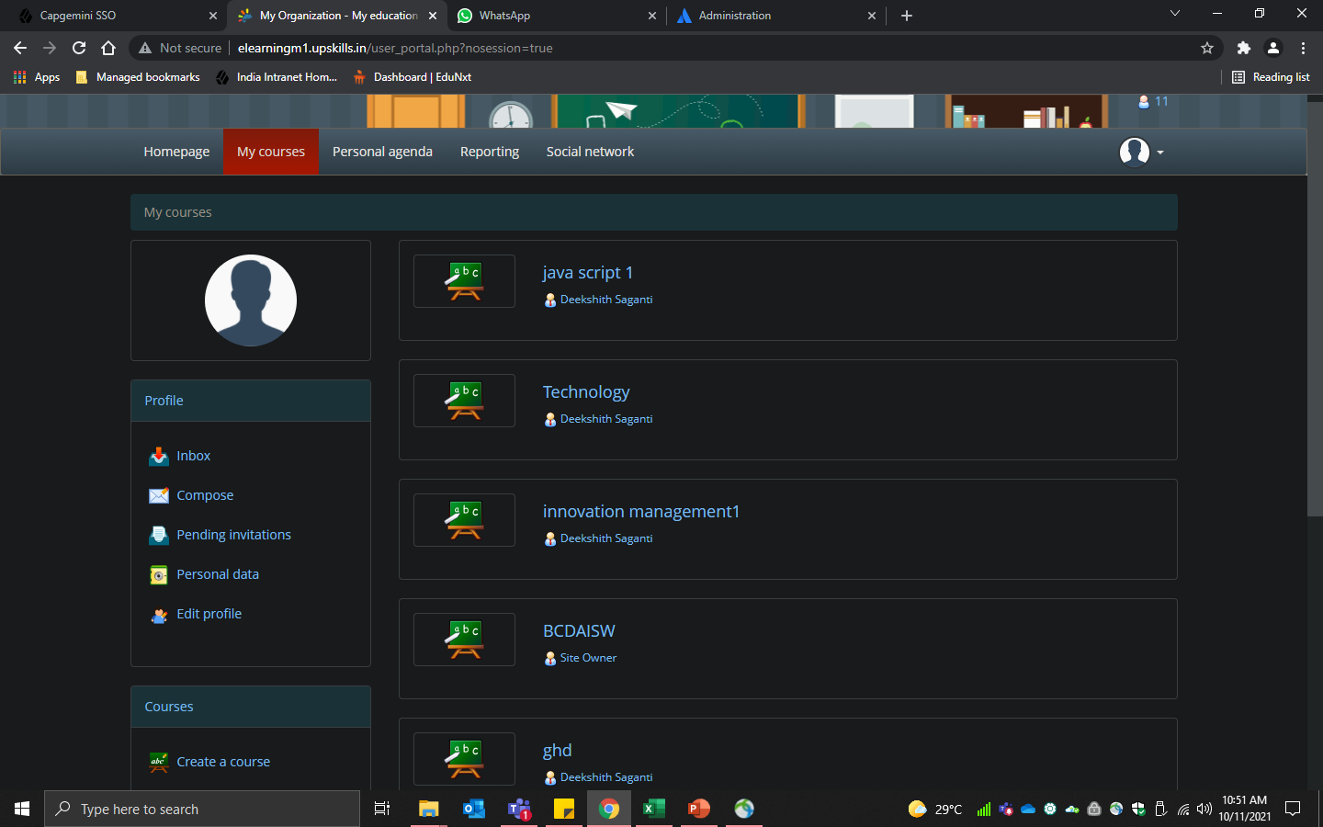
My Courses webpage

Slide 7
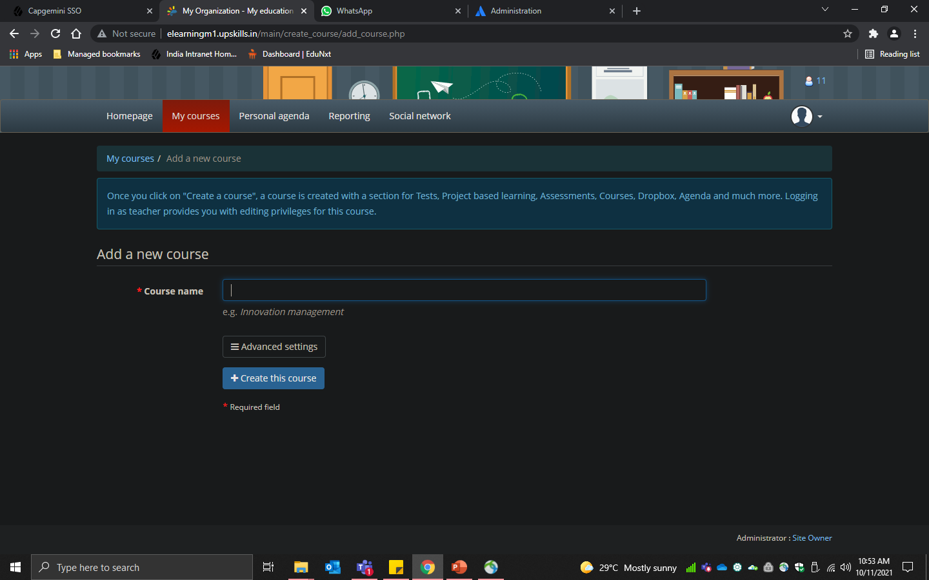
Create course

Slide 8
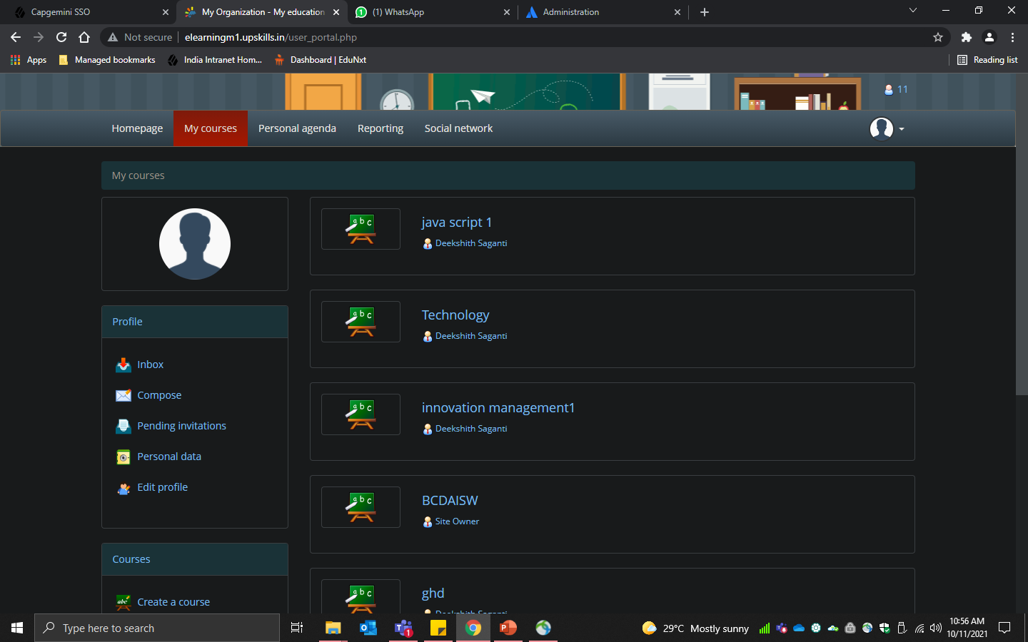
Course History

Slide 9
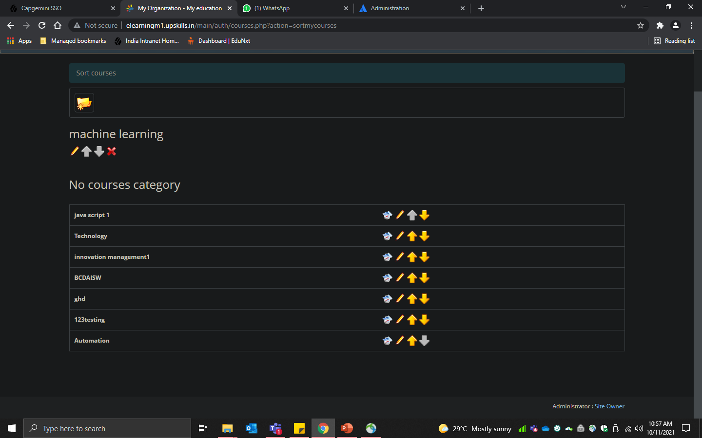
Sort Courses

Slide 10
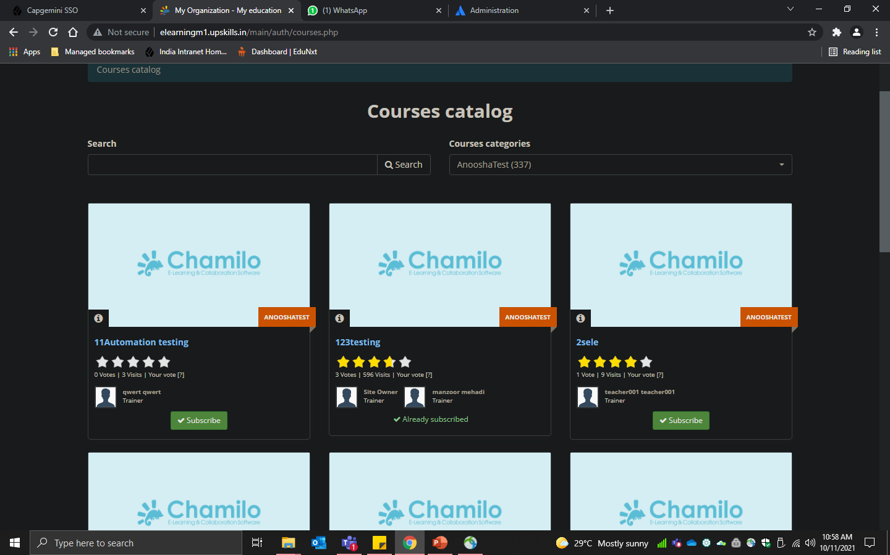
Course Catalog

Slide 11
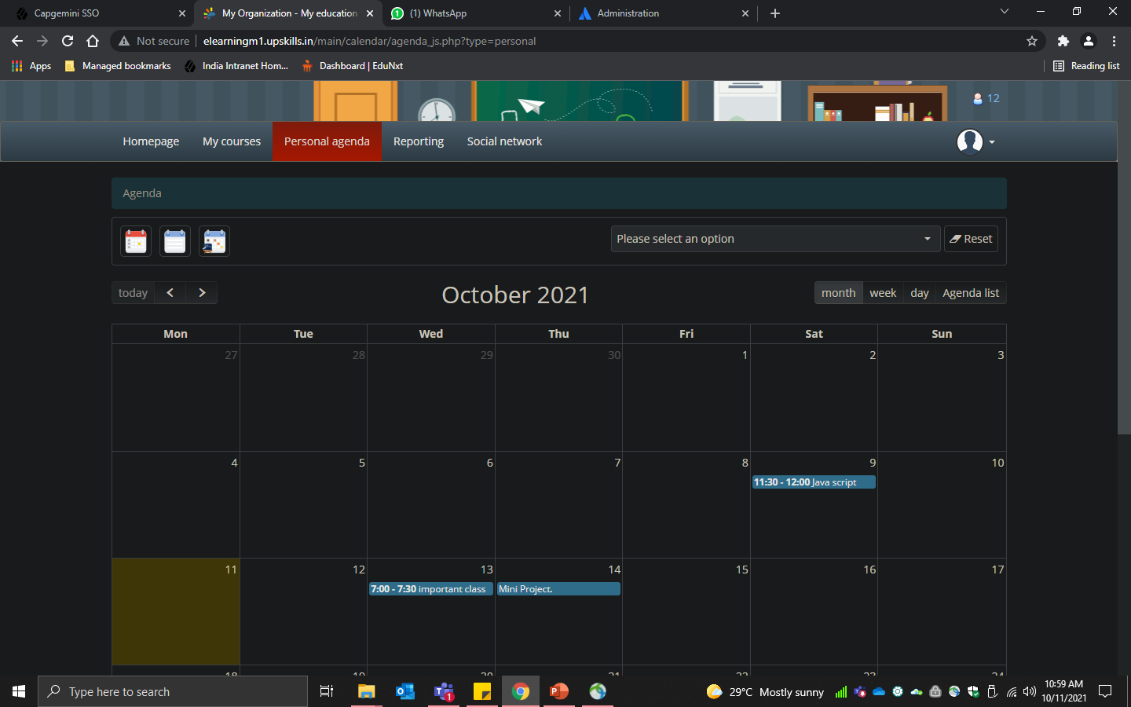
Personal Agenda Webpage

Slide 12
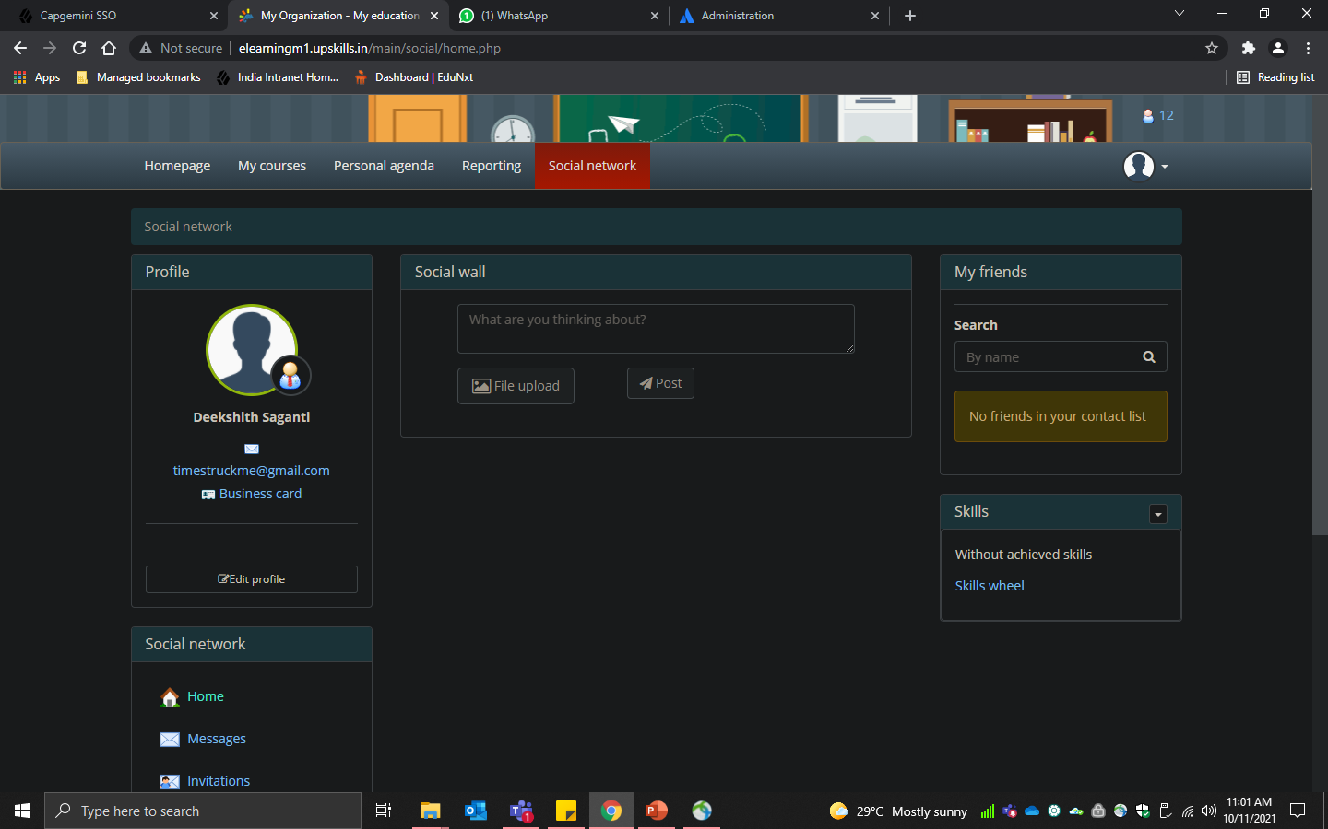
Social Networking Webpage

Slide 13
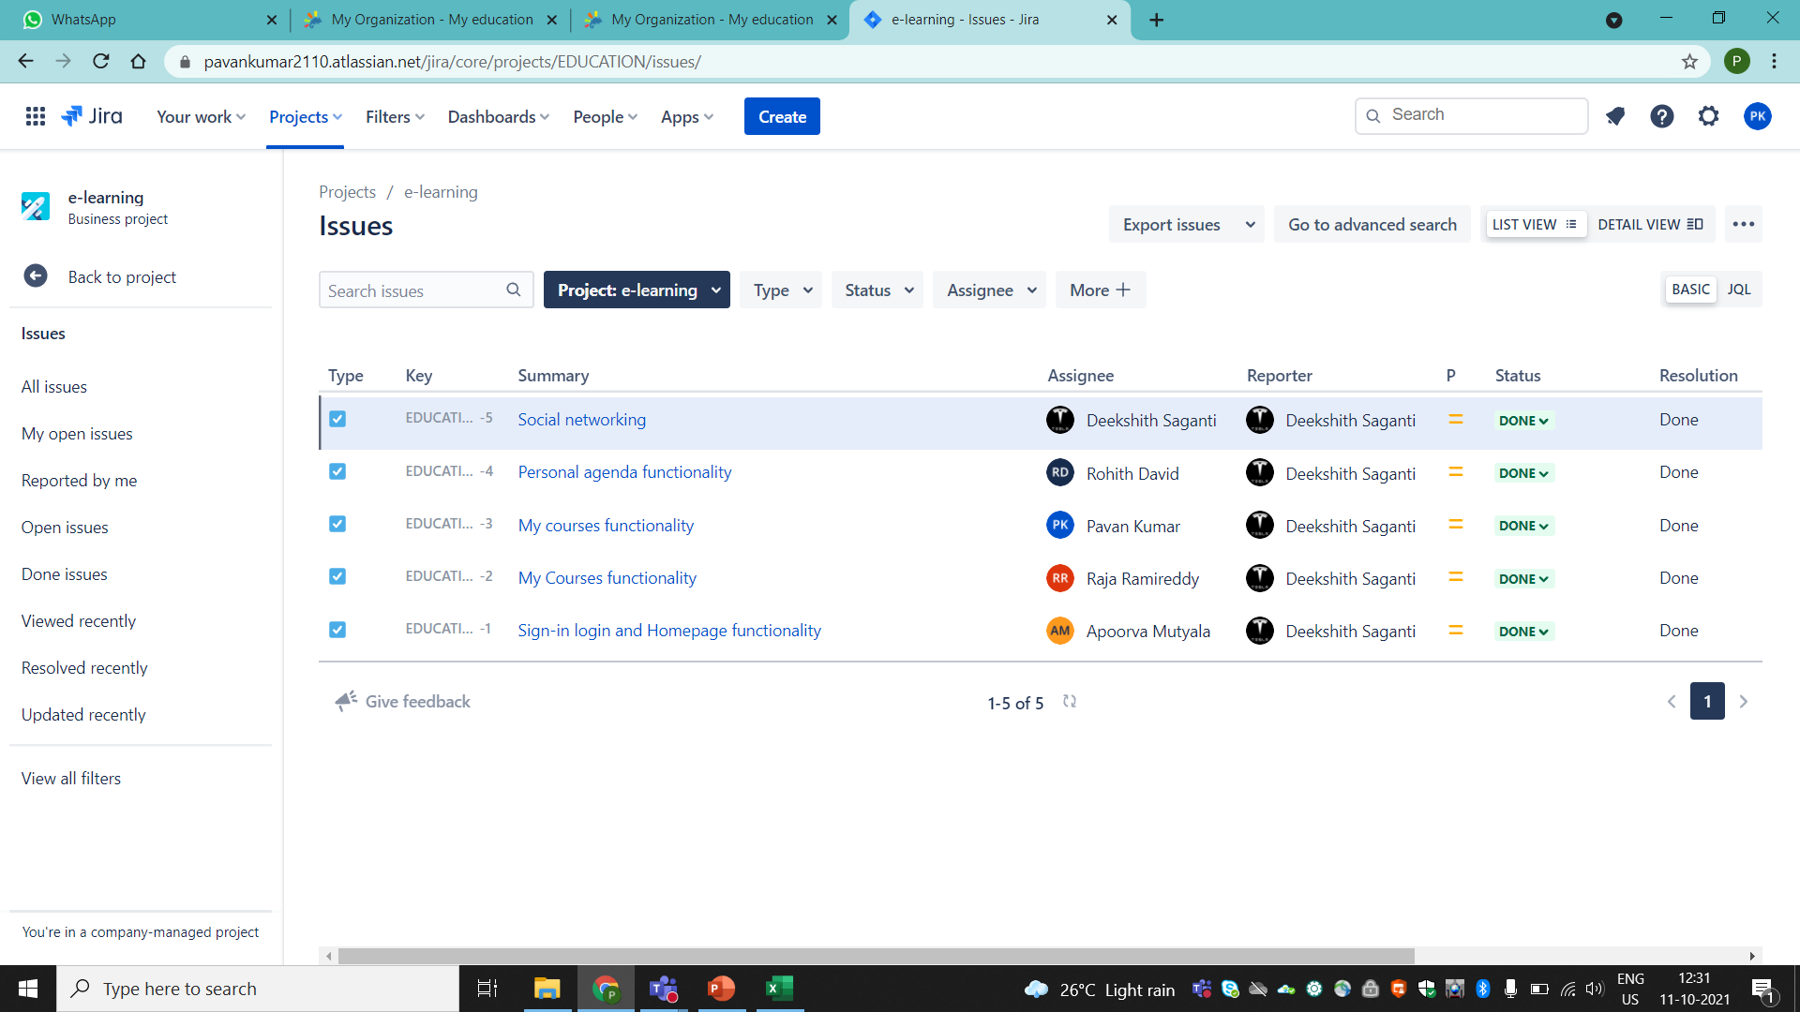
Project assignation in Jira

Slide 14
Advantages of this website

Slide 15
Conclusion

Slide 16
Thank You,,,,

